Slide 1
Ascension Technology
C.A.R.
Matthew Darby, Maggie Burton, Weston Straw, Mark Du, Andrew Case, Stevie Damrel

Slide 2

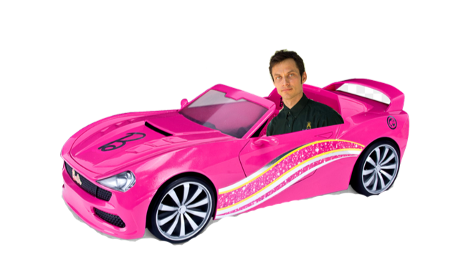
Where we are now

Slide 3
Class Diagram

Slide 4
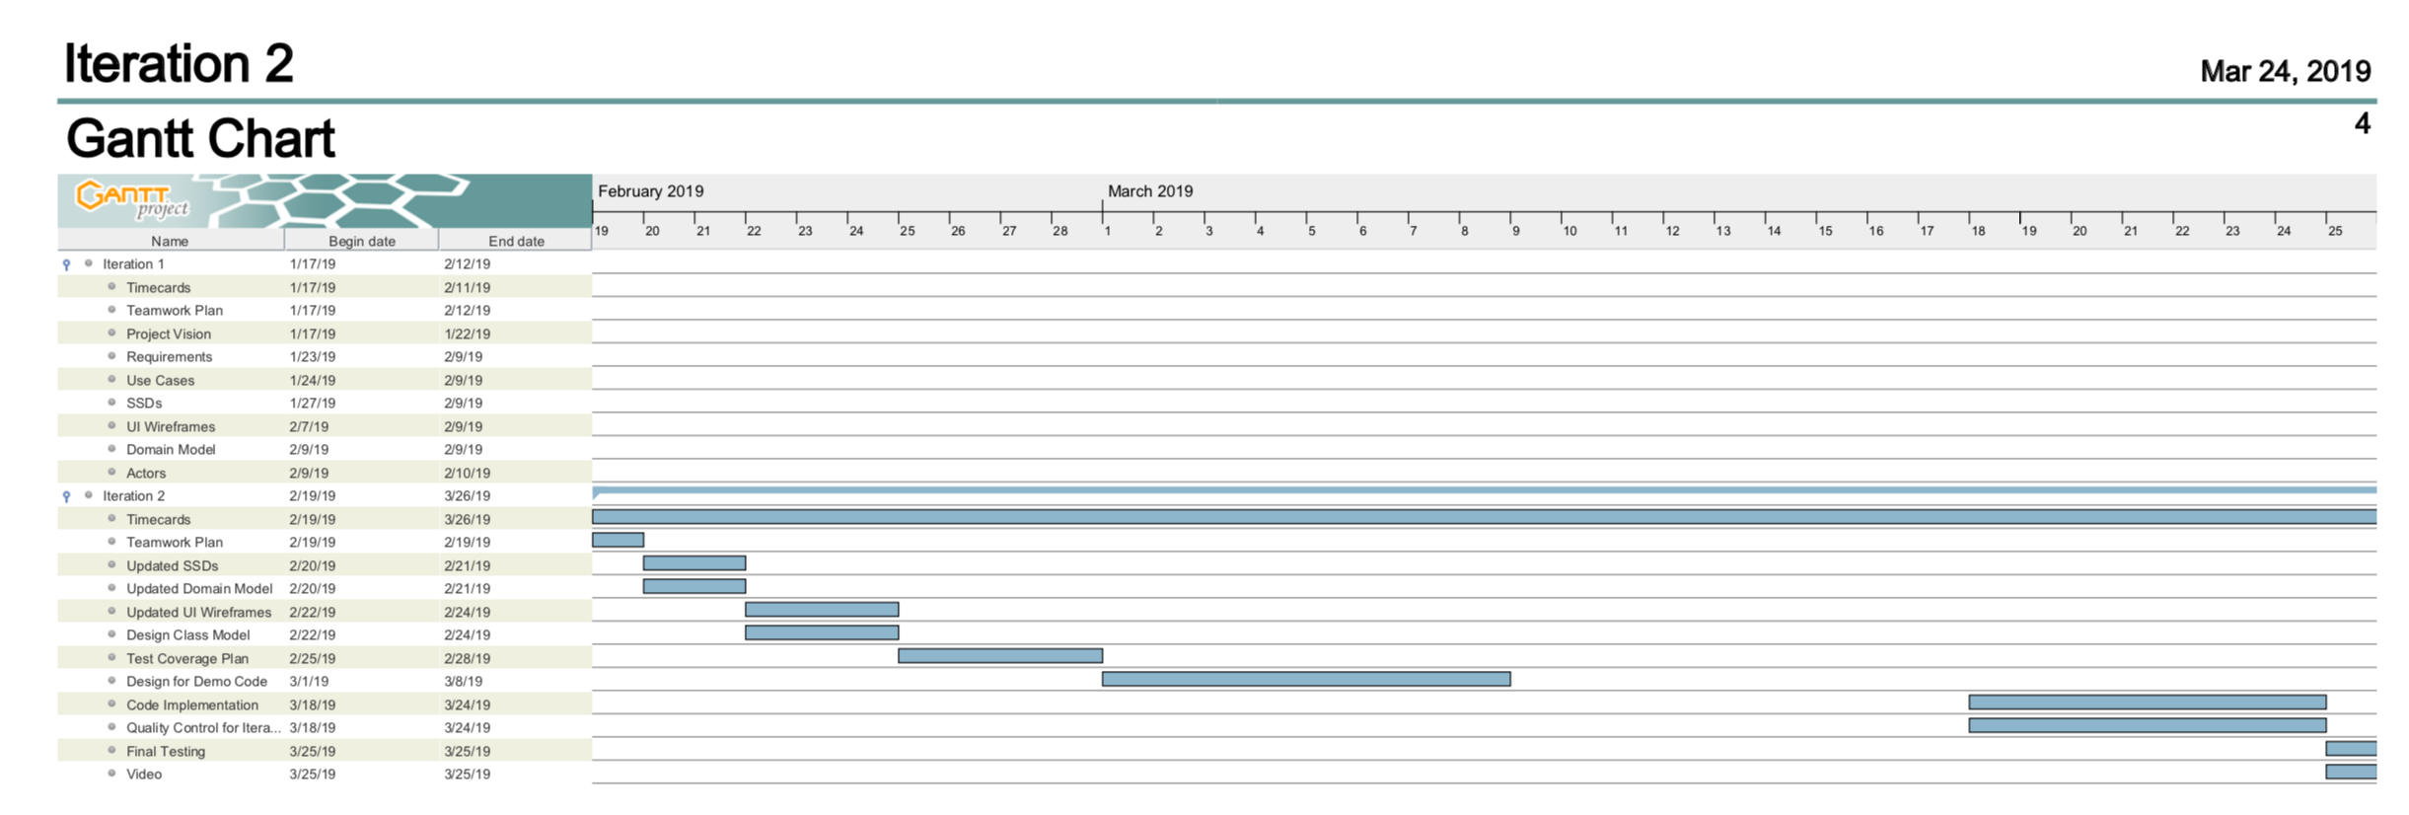


Slide 5

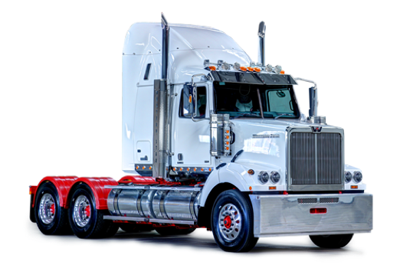
And now for a demo…

Slide 6
Communication Diagram: User Rent Car

Slide 7
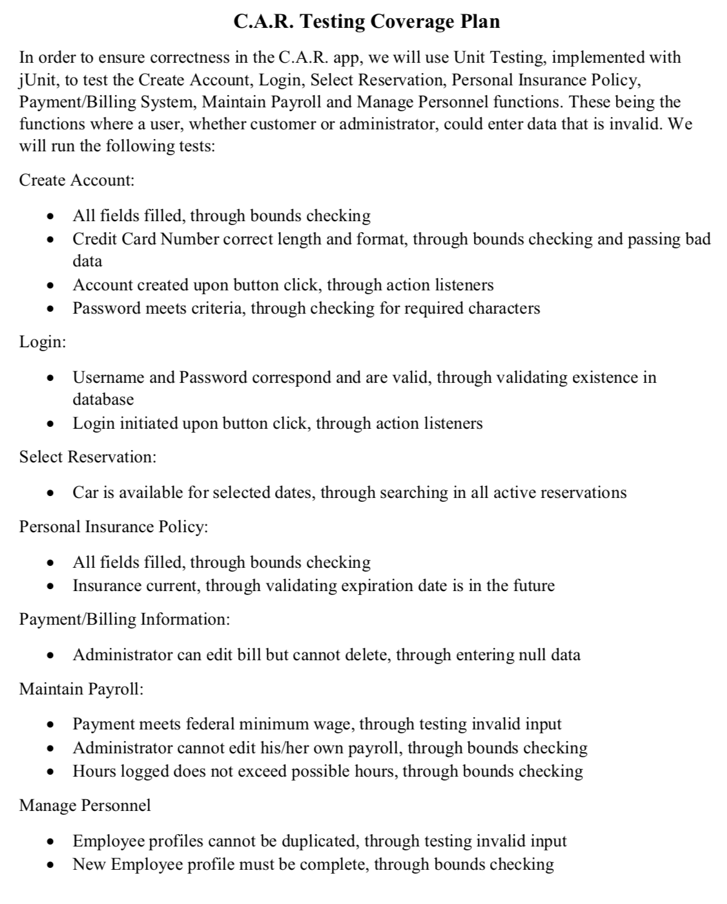

Slide 8
Website
https://baylorsailor.github.io/C.A.R./site

